Slide 1
Week 8
NX9523: Business Professional Practice
Notes:
1

Slide 2
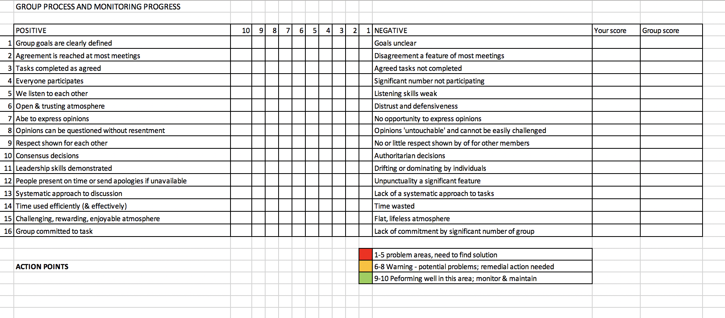
Reflective Statement – Group Review
You have been asked to keep notes and records that you can reflect on later
The Group Review sheet (shown above) will help you understand how your team is performing and whether any action needs to be taken
The process can be completed in week 11 so you can compare scores and see if there is improvement
Notes:
2

Slide 3
Group Review – How to
1. Individually, give a score of between 10 (excellent) and 1 (very poor) for each area.
Notes:
3

Slide 4
Group Review – How to
2. Enter your individual score for each area in this column
Notes:
4

Slide 5
Group Review – How to
3. Ask one of your team members to calculate an average of all the team members’ scores for each area and enter it into this end column .
Notes:
5

Slide 6
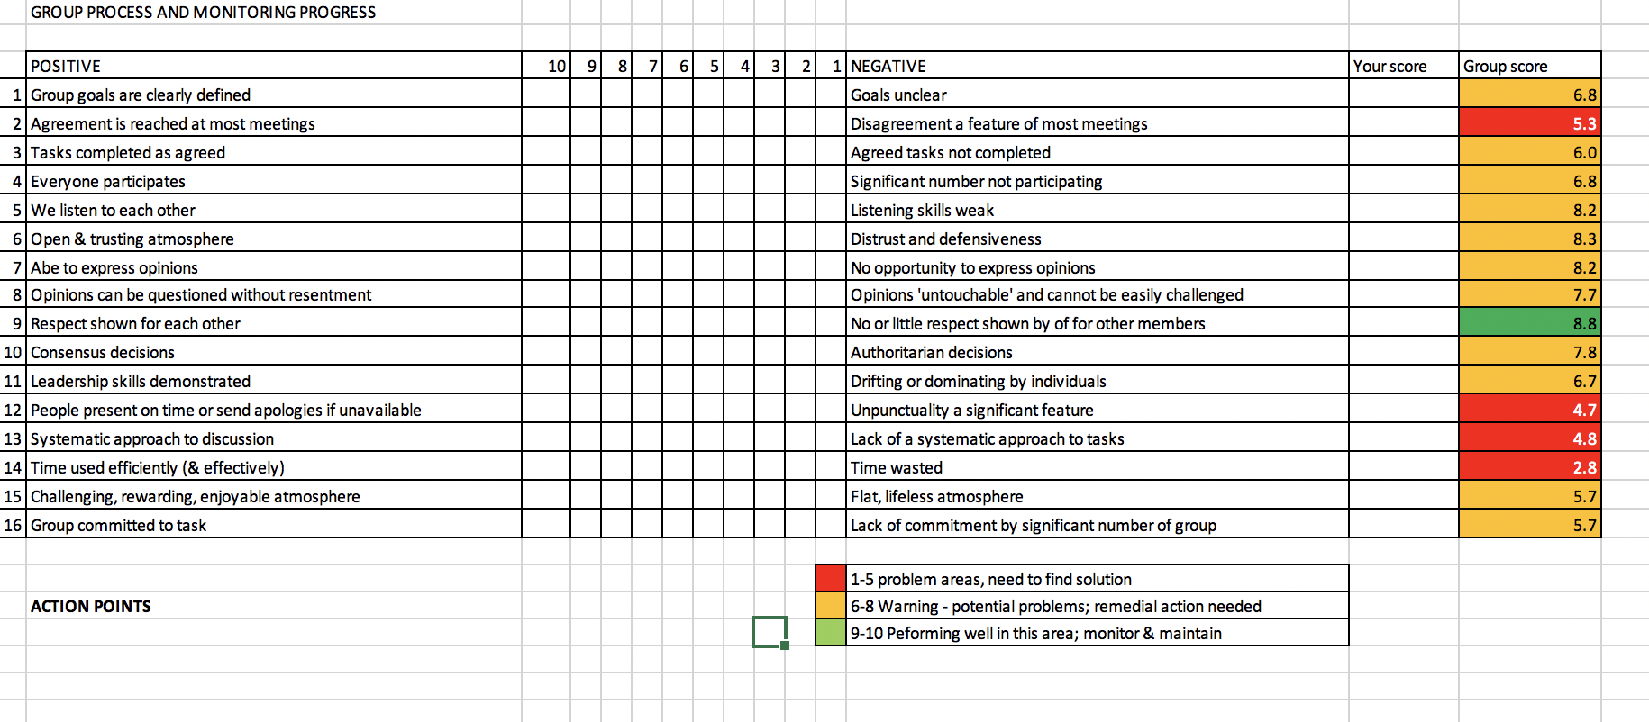
Group Review – How to
4. Colour code your group scores according to the key
This is a completed example.
Notes:
6

Slide 7
Group Review – How to
5. Discuss your results with your team.
Were there any surprises?
Green are areas where you are currently doing well – this needs to be maintained.
Amber areas need to be worked upon and Red require urgent solutions.
Discuss how any Amber and Red areas will be resolved.
Undertake the same activity again in Week 11. Have there been improvements?
Use this information in your INDIVIDUAL REFLECTION!
Notes:
7

